Slide 1
Coding?
Where do I start!

Slide 2
Build a Recipe: The concept
How to bake a cookie:
Preheat the oven
Mix wet ingredients
Mix dry ingredients
Combine wet and dry ingredients
Bake for time
Cool on cooling rack
Enjoy!

Slide 3
Each step has many user defined options
Mix the wet:
Applesauce
Milk
molasses
Granulated Sugar
Maple
Eggs
Brown sugar
Honey
Cinnamon
Sour Cream
Butter
Almond Extract
Vanilla

Slide 4
Recipe: defining the step
Mix the wet:
1 c Butter softened
¾ c brown sugar
1 egg
1 tbs honey
1/2 c sour cream
1 tsp Vanilla

Slide 5

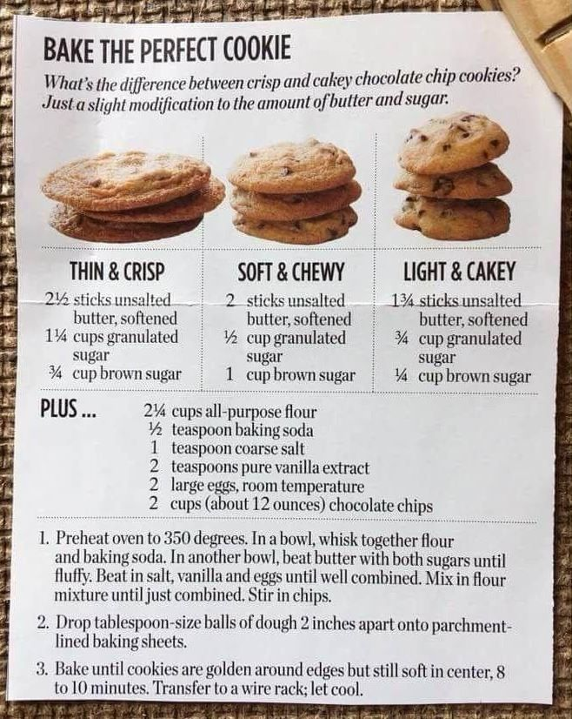

Slide 6
Find the goal, identify the steps
What’s available in the pantry: (crowdsource):
1) eggs
2) Bwn sugar
3) Vanilla
4) Flour – all purpose
5) Granulated sugar
6) salt
7) Butter
8) Cinnamon
9) Bking pwdr
10) Bking soda
11) Choco chips
Make the most average cookie based on ingredient I have in my house:
Info about dataset: compilation of X number of recipes
Talk through steps:
Clean:
Isolate each ingredient
Average each ingredient
Build final list
Notes:
Diana will discuss the dataset. Looking at the data what decision points need to be made about the data. Eg – if chocolate is selected as a variable, what kinds of choco may be a necessary step. What else does the class see?

